Slide 1
Wecon Servo&Motor
Notes:
Thanks for watching the video. Today we are going to introduce the recent release of VD2 servo.

Slide 2
Servo & Motor Product line
VD1 Series
VD2 Absolute
VE Series
400W~750W
single-core DSP
Tamagawa 2500 PPR
Parameter Self-tuning
Virtual DI
4-channel real time oscilloscope Vibration suppression
200W~750W
17bit/23bitabsolute encoder
Dual-Core DSP+FPGA
Multistage position, multistage speed
Holding brake support
Load rate view
Fault playback
200W~2.3KW
EtherCAT
Higher performance CPU
Faster response
Higher accuracy
2020
2021
2019
VD2 Series
VD2F Lite
1.0KW~2.3W
Tamagawa 2500 PPR
Dual-Core DSP+FPGA
Multistage position, Multistage speed
Holding brake support
Load rate view
Fault playback
200W~750W
Single board design
Position pulse economy type
17bit absolute encoder
Pulse frequency monitoring
Load rate view
2020
2021
Notes:
The history and development plan of WECON Servo.
The first generation of servo VD1 was born in 2019, only 400watt and 750watt, using a single-core DSP plus 2500 lines of optical encoder, according to feedback from after-sales, although performance is as good as top brand in critical situation, but good
reliability gains the reputation for further VD2 development
In 2020, we launched the VD2 series of servos with new models added from 1000watt to 2300watt. Same 2500 lines of optical encoder, but the CPU has been upgraded to dual-core DSP and FPGA
After that, absolute encoder of VD2 servo was introduced, which supports absolute encoders ranging from 17bits to 23 bits, and the model also covers 200watt to 700watt.
In fourth quarter in 2021, an economical version of servo VD2F will be launched. On the basis of VD2, some uncommon functions such as analog input and position feedback will be removed to make it competitor in the market.
Also in fourth quarter of 2021, the high-performance servos VE is available for testing which supports EtherCAT communication. Definitely, it must be more power hardware platform.

Slide 3
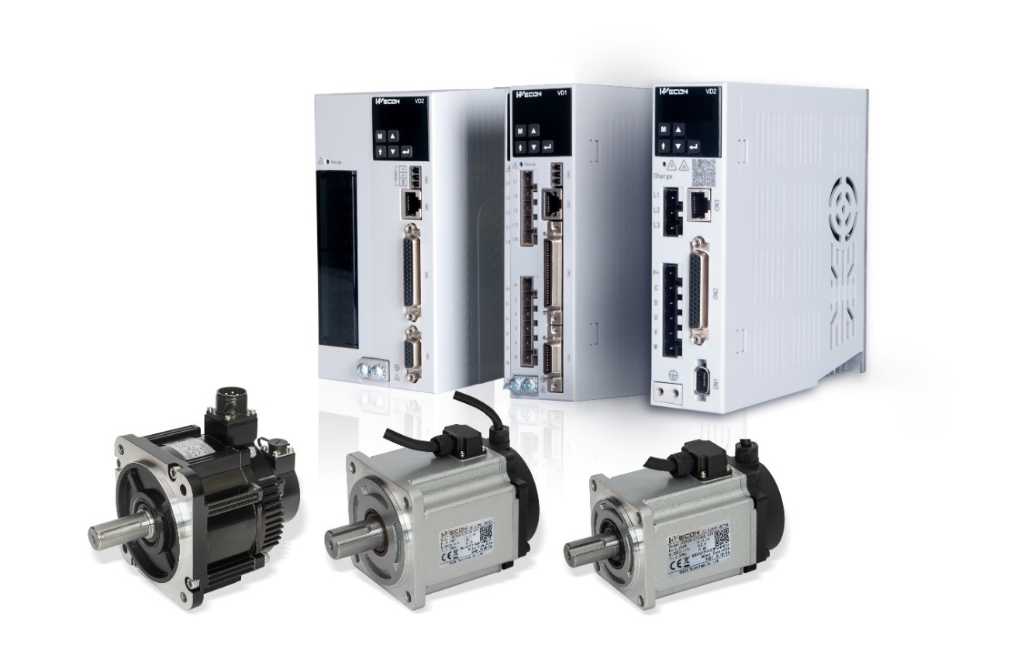
VD2 Series
◇ Using dual core DSP + FPGA processing, the response speed is
increased by 4 times;
◇ 23 bit absolute value, incremental encoder interface (optional)
◇ Motor coating protection to prevent corrosion damage;
◇ Automatic parameter self-tuning;
◇ Virtual DI/DO, four channel real-time oscilloscope;
◇ Internal multi segment speed command;
◇ Instantaneous load rate and average load rate monitoring;
◇ Fault record panel playback,
◇ Holding brake output control;
◇ Internal multi segment position instruction;
◇ Real time automatic identification of load inertia;
◇ Pulse frequency monitoring;
Notes:
Now I going to introduce VD2 series of servo in details, VD2 has the same gray color scheme as VD1. There are two appearance, A type is smaller size for 200watt to 750watt only. B type is bigger for 1000watt to 2300watt.
Here are some brief characteristic of VD2
With dual-core hardware scheme, 4 times faster in response speed than VD1. Absolute and incremental encoders are available for choices

Slide 4
VD2 Motor

Slide 5
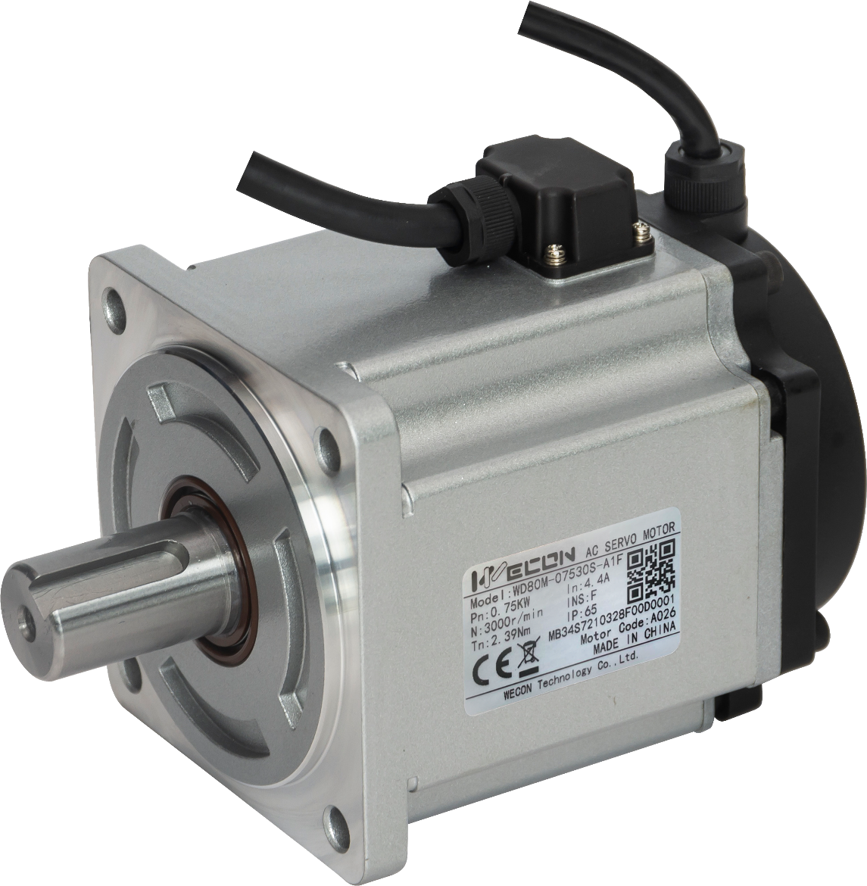
VD2 Series
Notes:
Here is picture of motor of VD2, for 750 watt, 80 flange.

Slide 6
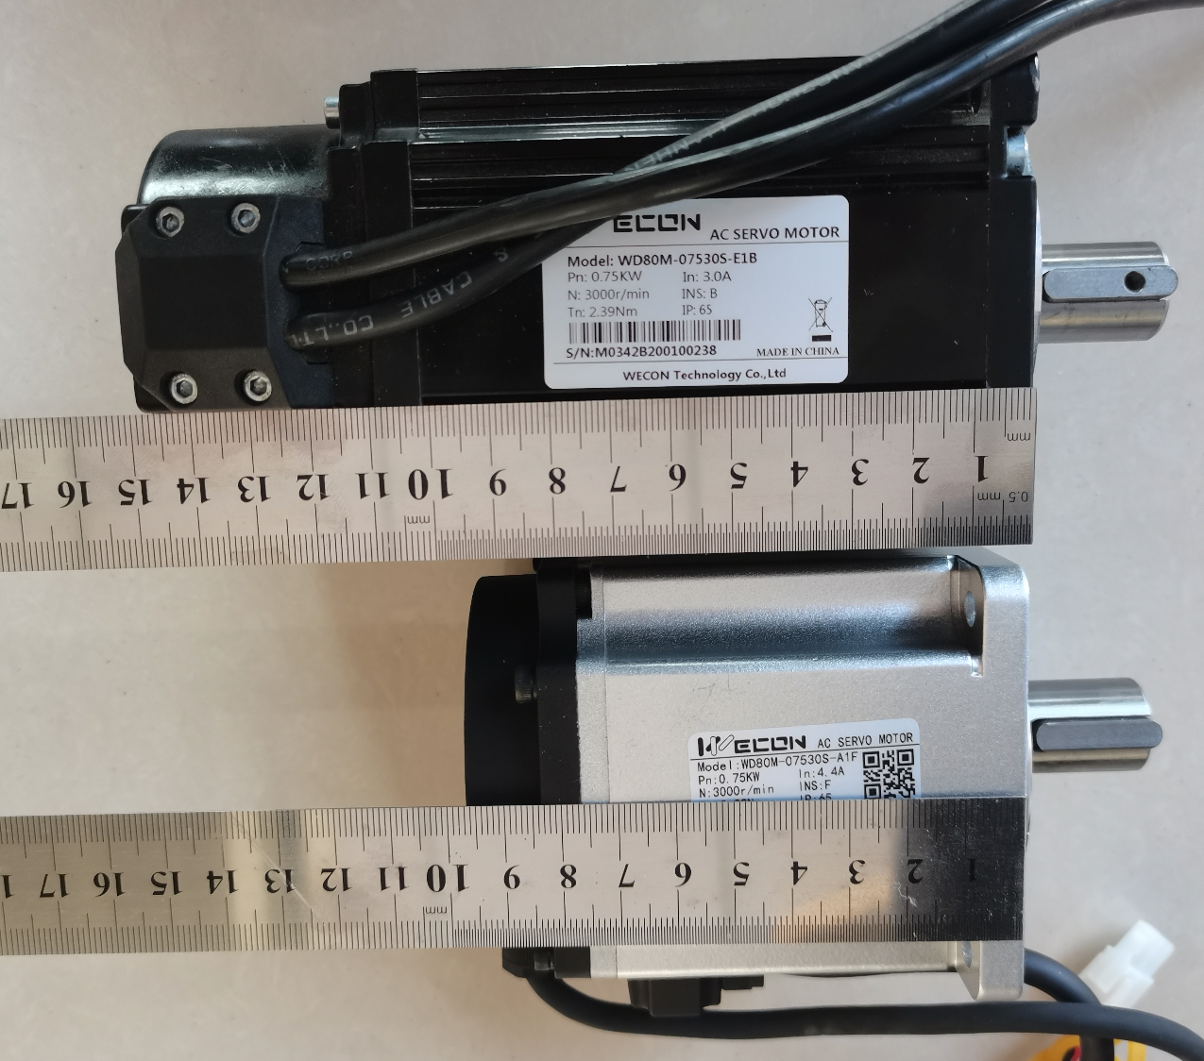
VD1&VD2 Motor Comparison
Notes:
Let's make a comparison. The motor at the top of the picture is a VD1 750watt, 80 flange motor, and the bottom is a VD2 750watt, 80 flange motor. The upper part is about 15cm, and the lower part is less than 10cm. The size is much shorter.

Slide 7
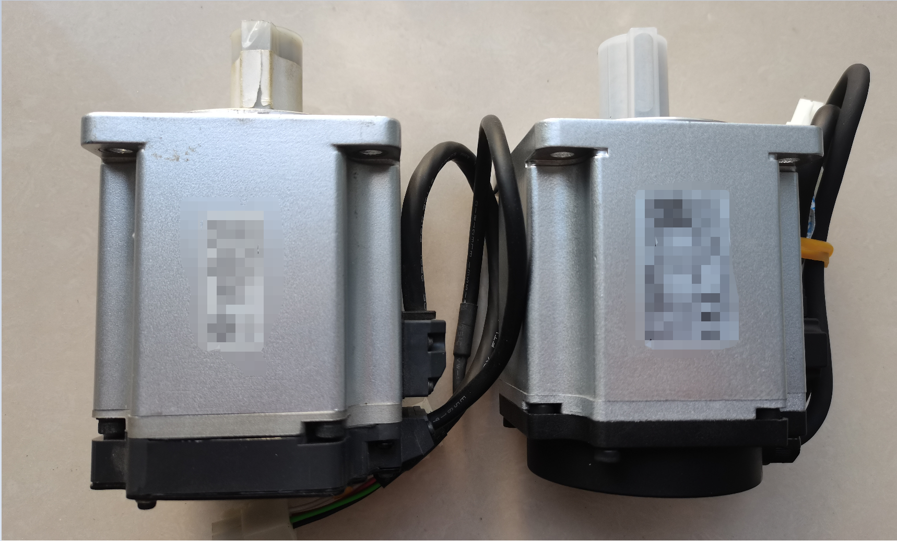
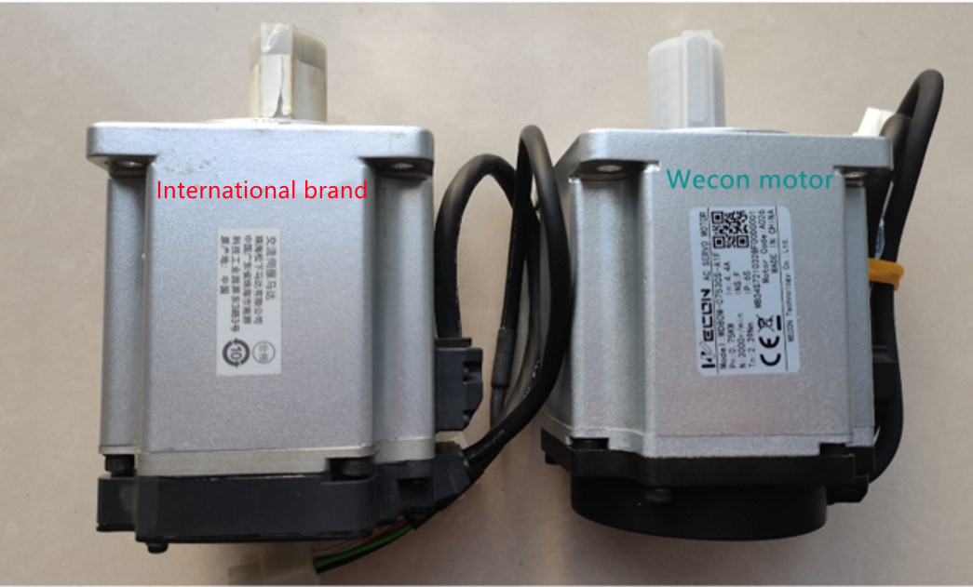
VD2 Series
Notes:
In this photo, the left is the 750watt, 80 flanged servo motor of a famous brand, and the right is the 750watt, 80 flanged motor of WECON's VD2. WECON has achieved the smallest motor of its class on the market.

Slide 8
VD2 Series
The third generation 5-pole motor
Fuselage integrated design
Smaller volume of the motor, using the split encoder
TPI bearing
N38SH grade magnetic steel, working temperature up to 150 ℃
Class H enameled wire.
Notes:
Now let’s talk about the main characteristics of the VD2 motor:
The VD2 motor uses the third-generation 5-pole motor. The motor body and flange are integrated design, which is better protected, and more importantly, its heat dissipation effect will be better…….
We know that the inside of the motor uses a coil of enameled wire to generate a rotating magnetic field to push the magnetic rod inside the rotor to rotate. But the enameled wire will definitely generate heat, and the heat dissipation is related to the volume of the motor housing. The VD2 motor is shorter than the VD1 motor. How to ensure the heat dissipation effect? It is the one-piece design that conducts heat to the flange, and then conducts the heat to the machine through the mechanical structure. According to our actual test, under the same conditions, the temperature rise of the VD2 motor will not be worse than that of the VD1…….
In addition, VD2 also uses a split encoder behind the motor, so the length of the VD2 motor is shortened.
Among the components of the motor, the magnetic rod and the bearing account for a large cost. However, among various products, these two are also the parts that are most likely to be cut corners. It is difficult for customers to find problems in early applications. Only when the bearings are worn to a certain degree and the magnetic rods begin to demagnetize, the problems will appear………..
The VD2 motor uses TPI bearings from Taiwan, China, and enjoys a high reputation in the industry. The magnetic rod uses the N38SH standard, but some products use N38H. N38H has a temperature resistance of 120 degrees Celsius, and N38SH has a temperature resistance of 150 degrees Celsius. The slight difference in the standard is a huge gap for the product. In addition, our enameled wire uses H-level (180 degrees Celsius) high temperature enameled wire. In order to ensure the quality of the motor, we use better materials.

Slide 9
VD2 Servo Characteristic

Slide 10
VD2 Series
Fast calculation
VD1 Series
VD2 Series
DSP
Core1
Accelerator
Core2
Accelerator
FPGA
FPGA
Single-core
Dual-core
The speed of VD2 current loop is increased to 5K, 4 times of VD1
Faster calculation, faster response and more accurate control
Notes:
After introducing the motor, let's look at the characteristics of the VD2 servo drive .The most important characteristic of a servo drive is fast. How to make the servo drive faster? The WECON VD1 series servo has selected the DSP CPU+FPGA solution. We know that most other brands of servo products do not use DSP processors, but use relatively inexpensive ARM processors, such as ARM M0/M3/M4. The main strength of DSP is digital signal processing. For example, sound processing, image processing, and signal processing must use DSP for high algorithm requirements. This is widely used in the military, aerospace, and aviation fields. There are high-speed current loops, PIDs, and various filtering algorithms in WECON servo.
These are the strengths of DSP CPUs. Therefore, the VD2 series of servo drives not only still use the DSP CPU solution, but also use the dual DSP CPU, plus 2 additional accelerators, as well as FPGA as an auxiliary.
Through calculation, the VD2 current loop speed is increased to 5K, which is 4 times as VD1, which makes VD2 to calculate faster, respond faster, and control with more accuracy."

Slide 11
VD2 Series
Fast sampling
VD1 Series
VD2 Series
U-phase current
ADC_1
U-phase current
V-phase current
Bus voltage
ADC
V-phase current
ADC_2
Bus voltage
ADC_3
Notes:
In addition to fast calculations, we also sample fast. Our VD1 series has only one internal ADC. We use serial sampling. U-phase current, V-phase current, and bus voltage are sampled in turn through the same ADC, so sampling output is slow, and the current has to be output in next cycle. But our VD2 series has sufficient ADC, so U-phase, V-phase, and bus voltage can be sampled at the same time, plus high DSP processing, can achieve a single-cycle current output

Slide 12
VD2 Series
Accurate positioning
VD2 series servo can choose incremental or absolute encoder interface. It matches the 17 / 23 bit optical encoder or magnetic encoder built in the motor to improve the positioning accuracy of the equipment.
Encoder | Pulses per cycle
2500 ppr | 2500
17 bits encoder | 13 1072
23 bits encoder | 838 8608
Notes:
In addition to speed, another important parameter is accuracy. VD2 supports maximum 32-bit encoder, and there are approximately 8.38 million pulses per revolution, so the positioning accuracy is very high. The encoder not only affects the positioning accuracy, but also affects other performances. In a small range, the high-speed DSP can quickly recognize whether the motor's rotation trend is faster or slower, which shows higher sensitivity of the servo, and stronger rigidity of the servo.

Slide 13
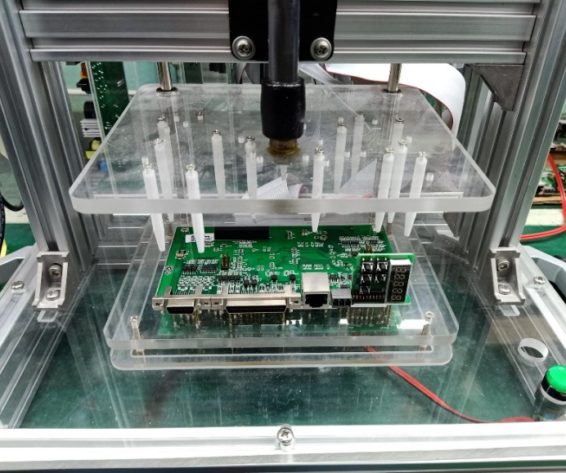
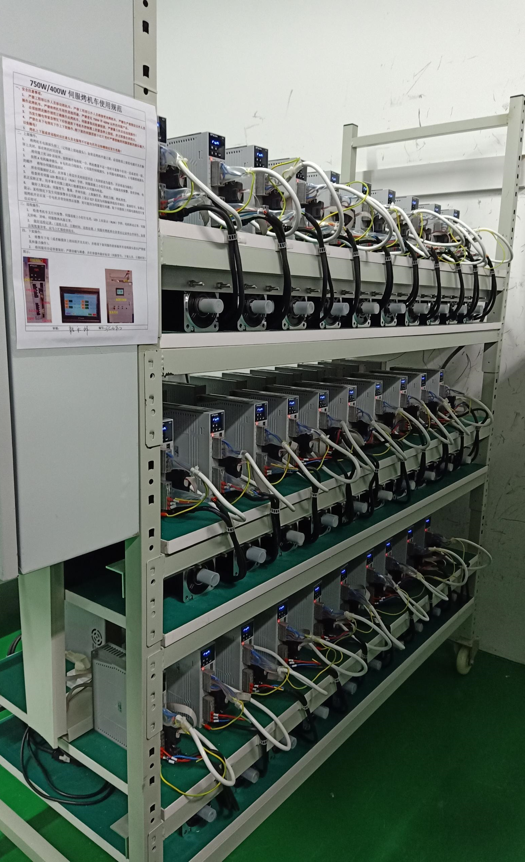
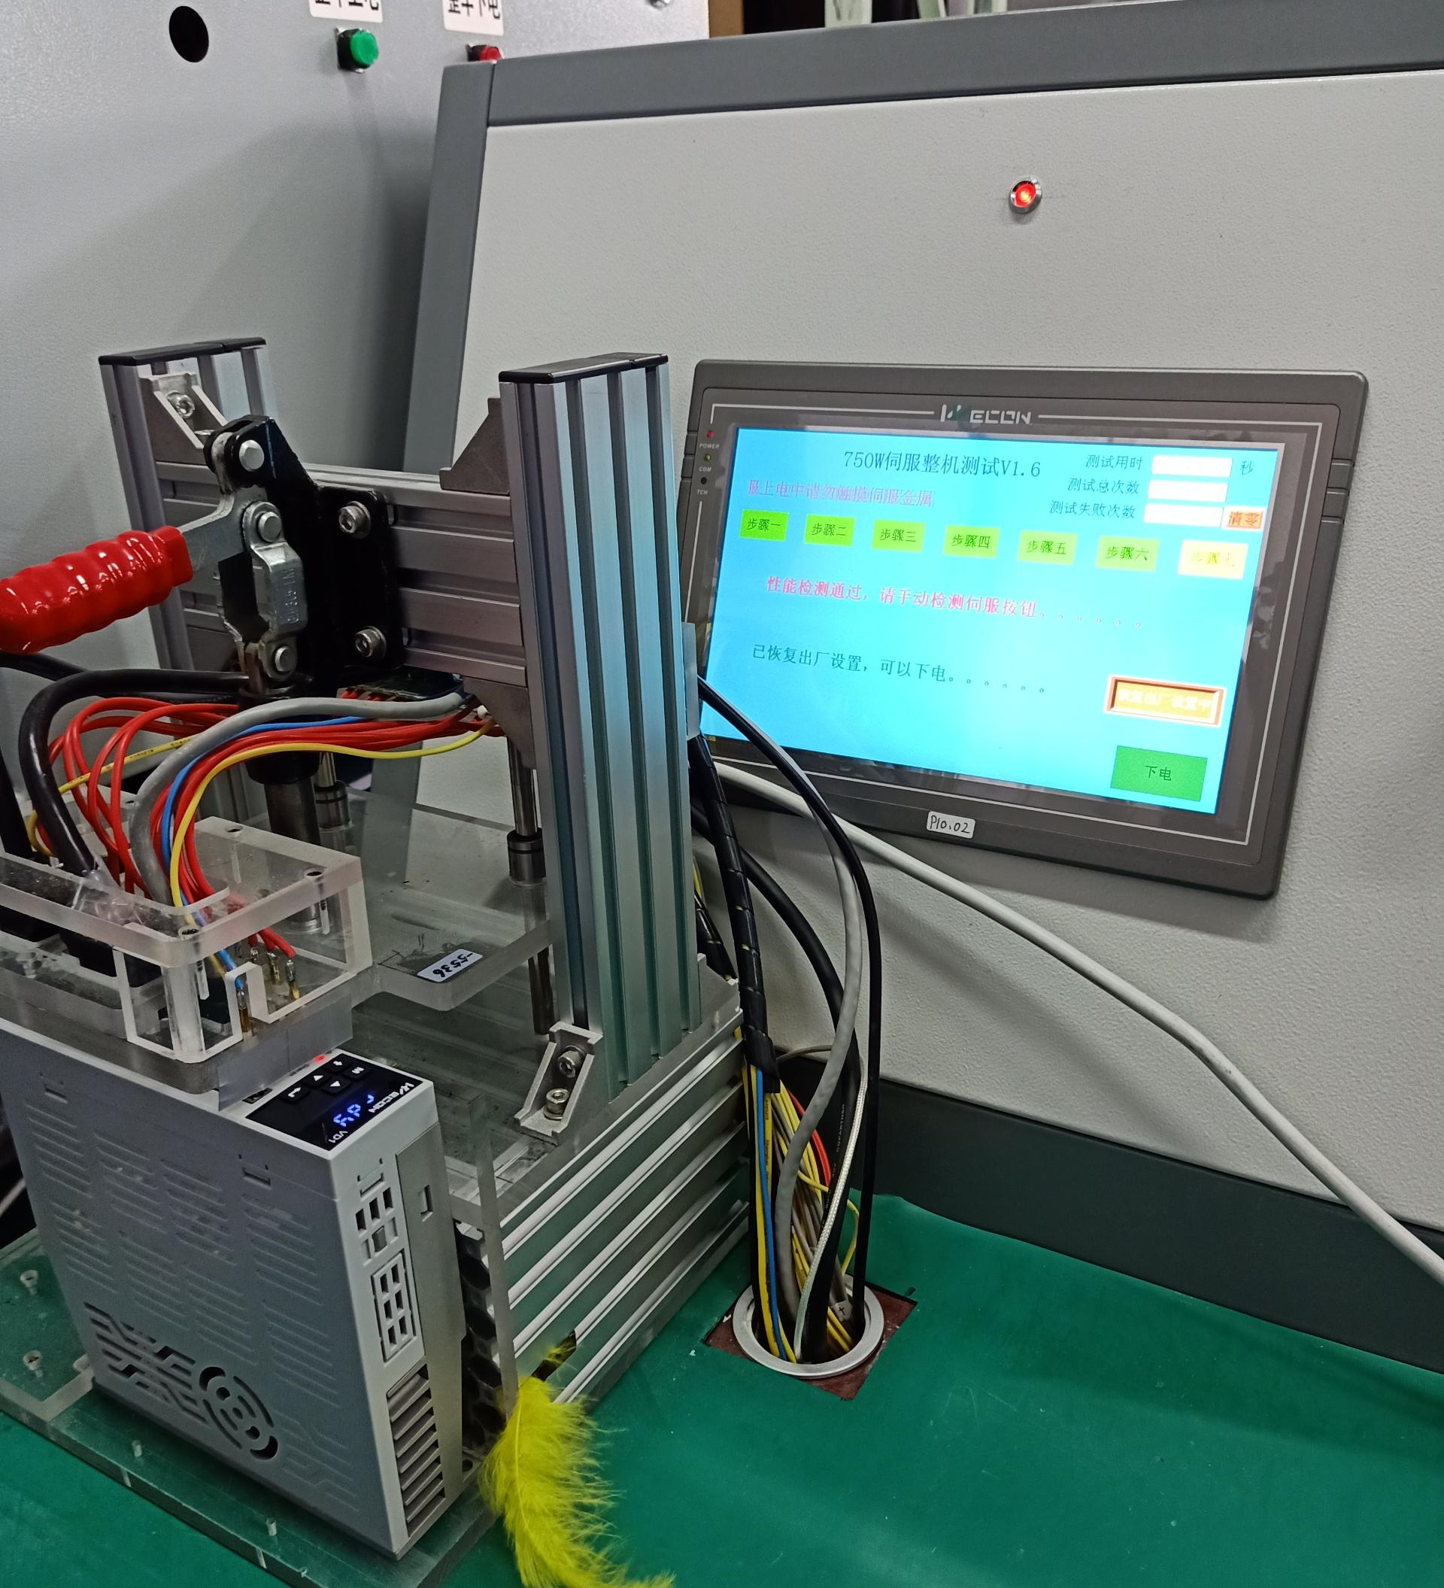
VD2 Series Servo
Select components of famous brands at home and abroad
Rigorous experimental testing
Each servo and motor leaves the factory after aging
Perfect self detection and fault alarm
Conformal coating protection
Notes:
Reliability is the essence of industrial automation. In order to ensure the reliability of our servo, First, we use components from well-known brands.
Second, in the production process, such as the production of boards, we have strict con-formal coating, and thirdly,
Third, we have strict tests,
The picture in the upper left is the picture of our board test, and each board has been strictly tested.
The following picture is our factory test of the whole machine. The servo can only pass the factory test after running it on this whole system.
The picture on the right shows high temperature aging. All servos must be running in a high temperature environment for more than 4 hours.
In addition, our servo is equipped with self-checking and fault alarm functions. When there is a problem, the servo can stop immediately to avoid the expansion of the fault.

Slide 14
VD2 Servo Practical Function

Slide 15
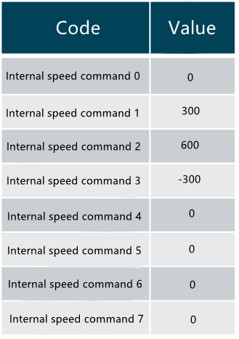
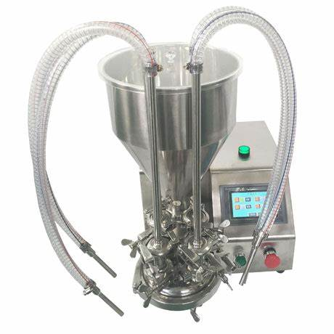
Multi Speed Command
Function description
Application: Cream Extruder
8 segments of prefabrication speed command;
Select the corresponding input through Di input;
Acceleration time and deceleration time can be set;
Speed command digital input, precise control;
Through I/O control motor start, stop, reverse;
Speed
600 rpm
300rpm
0 rpm
-300 rpm
Time
INSPD3: 0
INSPD2: 0
INSPD1: 1
speed 1
INSPD3: 0
INSPD2: 0
INSPD1: 0
speed 0
INSPD3: 0
INSPD2: 1
INSPD1: 1
speed 3
INSPD3: 0
INSPD2: 1
INSPD1: 0
Speed 2
Notes:
Below we introduce the commands of our servo characteristics,
The first one is the multi-step speed command function. Our servo can have 8 built-in different speeds. Through the DI input on the servo, we can control the specific running speed.
The following figure shows that we can accurately control different speeds through internal commands.
The typical application of this commands is the application of cream extruder.

Slide 16
Multistage Position Command
Function
Application : Automatic Punch Feeder
8 independent displacements;
The target displacement of each segment is set separately;
The maximum speed and acceleration time of each displacement section are specified separately;
Set the waiting time between each displacement;
DI start displacement can be set;
According to the target machine, the displacement value is set;
According to the acceleration and deceleration time and speed settings, the target is moved;
Set the waiting time according to the processing time;
1st displacement
2nd
3rd
Notes:
Similar to multi-stage speed command, servo DI control and start displacement
We can see this example. After I control and drive the displacement of the bow and arrow through DI in different stations, I can realize the first displacement station to the second station, the third station, to the fourth station, and finally return. To the origin of the first station

Slide 17
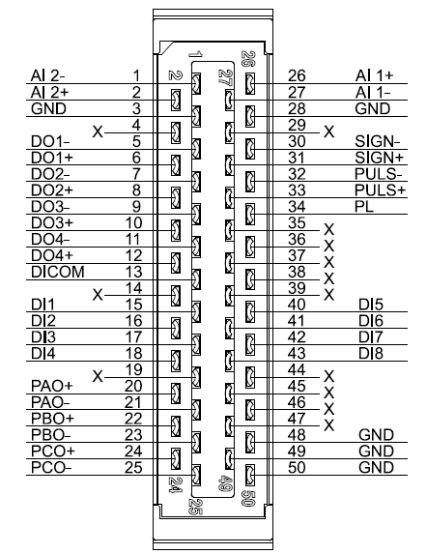
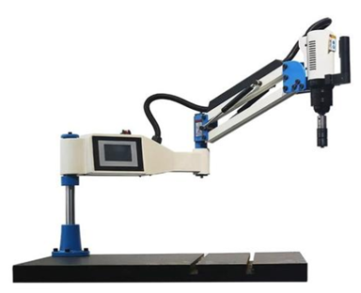
Virtual DI control
Function
Reduce physical wiring;
In debugging field, DI input is realized without wire welding;
Realize internal servo enable;
RS-485 communication controls DI input;
Application tapping machine
Write script on HMI to control Di start signal;
Use internal position command to realize tapping machine operation
Notes:
When we need to use a lot of input IO ports and DI for the servo, too many wiring causes inconvenience.
In order to reduce wiring or when the number of PLC output points is not enough, It can be used to change the function. this function is to control and realize the virtual DI input through the 485 bus, which is convenient for on-site wiring. A typical example is a tapping machine.

Slide 18
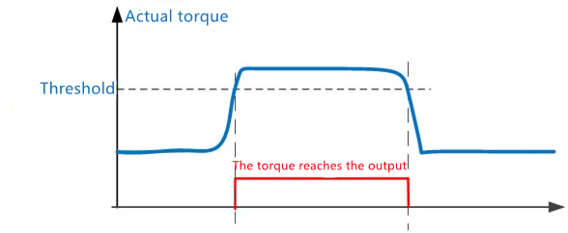
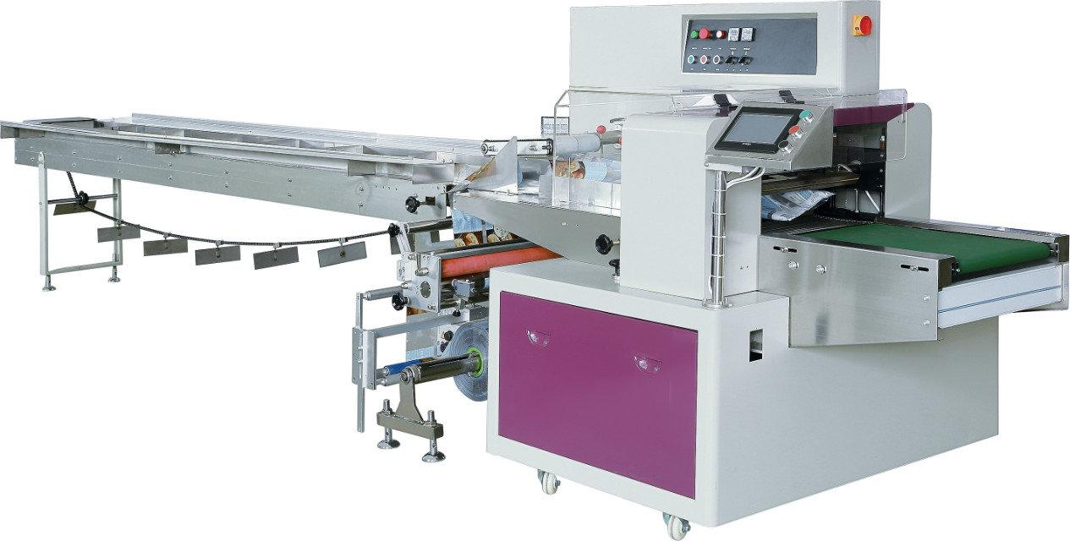
Torque Reaches Output
Function
When the actual torque reaches [torque reaching threshold], the torque reaching DO becomes effective;
Application Packing Machine
When the cutter cuts the material, the actual torque of the servo becomes larger;
Servo driver outputs IO signal to PLC;
After the PLC detects the torque signal, it controls the cutter to reverse and exit.
Notes:
A torque reaching threshold is set internally in the servo. When the torque is reached, there will be a valid DO output to notify the PLC that the torque has arrived.
A typical case is a packaging machine. The knife of the packaging machine is constantly moving. When the material is accidentally cut due to abnormalities, the servo torque will increase. The PLC will be told through the output IO that the PLC will immediately request the cutter to return to avoid damage. .

Slide 19
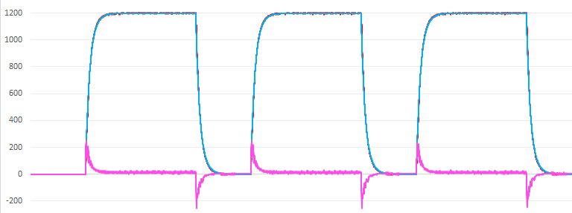
Real-time Identification of Load Inertia
On site debugging
Mechanical stroke too short?
Can't use tools to measure the load inertia ratio on site?
Is the load inertia ratio variable?
Real-time load inertia ratio
Code | Function | Unit | Modbus Address
U0-16 | Real-time load inertia ratio | 0.01% | 0x1E10
Notes:
When on site, many machines make less than two revolutions, or there is no computer on site, there is no way to identify the load inertia when the host computer, or the load inertia ratio is consistent……
However, it is necessary to know the current load inertia, so there is a tool for load inertia identification. As long as the PLC inputs acceleration and deceleration pulses to the servo, the advantage of the servo dual-core CPU can quickly calculate the load inertia ratio. Finally, it is displayed in the monitoring quantity U0-16. The value of the inertia ratio can be read out by pressing the key or communication. When the inertia ratio is found to be relatively stable, it can also be displayed in the parameters.

Slide 20
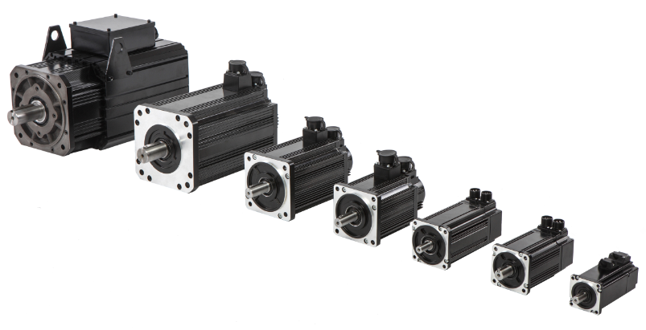
VD2 Servo New Function
On site debugging
Is the actual speed inconsistent with the target speed?
PLC sends pulse, but the servo motor doesn't work?
What's wrong with the pulse line?
Lost the pulse?
Field interference, servo work?
Is the pulse of PLC sent correctly?
Code | Function | Unit | Modbus Address
U0-12 | Input command pulse frequency | KHz | 0x1E0C
U0-33 | Instantaneous output power | W | 0x1E21
U0-34 | Average output power | W | 0x1E22
Notes:
U0-12 is mainly when the PLC sends pulses to the servo, the pulses may be inconsistent, or the PLC sends pulses,
the servo does not rotate, or the pulse line has interference problems, by observing the frequency of the servo pulse input and the frequency sent by the PLC. It is not consistent, and it is easy to troubleshoot problems on the spot.
U-33 and 34 can judge the load of the motor, whether there is overload, whether the output power is too large or too small, and whether the selection of the motor is correct.

Slide 21
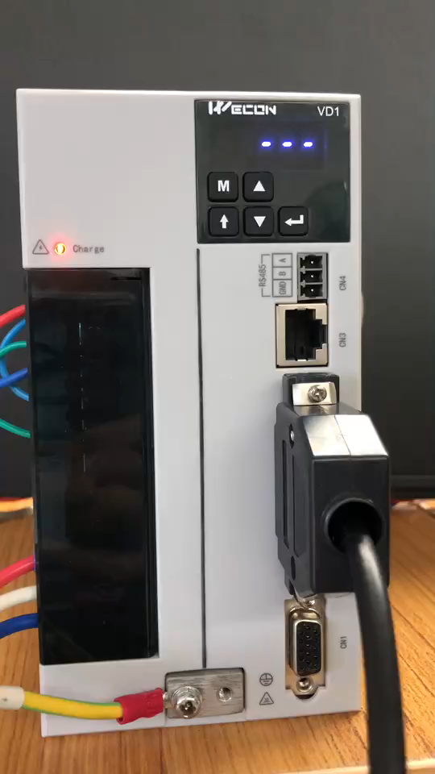
Fault Information Playback
In case of failure, the state of failure time will be displayed automatically.
U1-01 | Current fault code
U1-02 | Current alarm code
U1-03 | phase U current upon displayed fault
U1-04 | phase V current upon displayed fault
U1-05 | Bus voltage upon displayed fault
U1-06 | IGBT temperature upon displayed fault
U1-07 | Torque component when fault occurred
U1-08 | Excitation component when fault occurred
U1-09 | Position deviation when fault occurred
U1-11 | Speed value when fault occurred
U1-12 | the time when fault occurred
U1-14 | Number of faults
U1-15 | Number of warnings
U1-16 | Total number of historical faults
U1-17 | Total number of historical alarm
U1-18 | Last 2nd fault code
Notes:
This is the fault information browsing, U1 is the fault code. In case of failure, the state of failure time will be played automatically. You can hold down the "M" and "Shift" buttons, the drive will display the fault code and information of the last failure. Engineers can judge the problem based on the information.

Slide 22
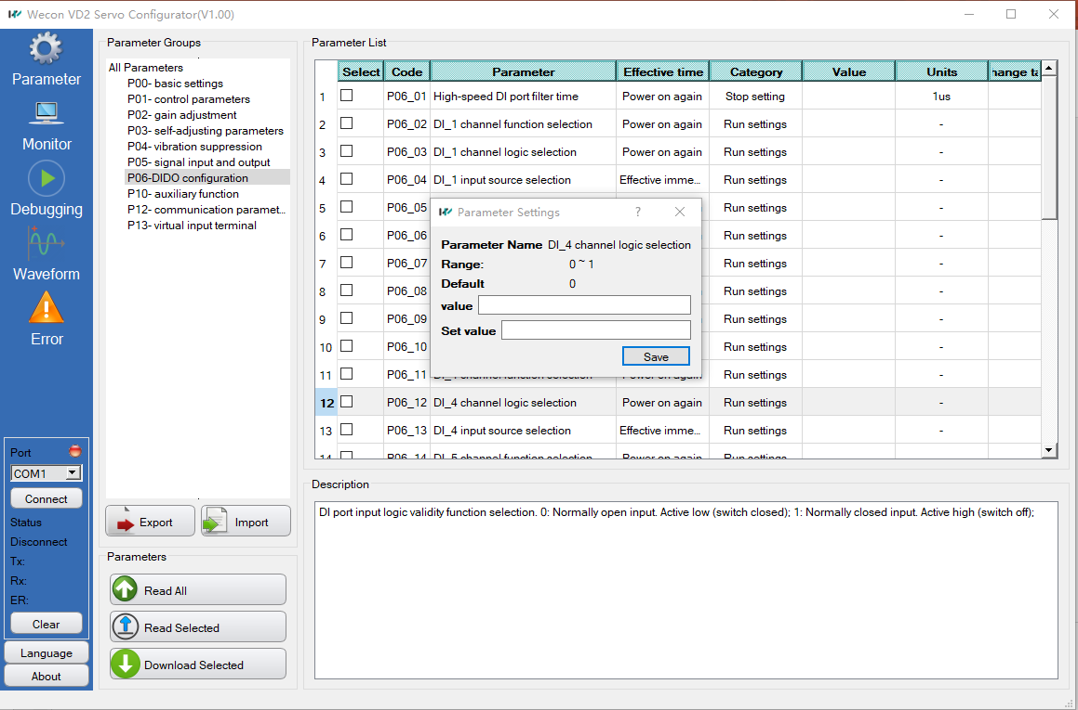
Servo Software
Notes:
This is the Servo software, you can set parameters in the software, monitor the running status of the servo, debug, view waveforms, and query faults. When you click on a parameter, there will be a description of the parameter below. When you double-click the parameter, you can set it.

Slide 23
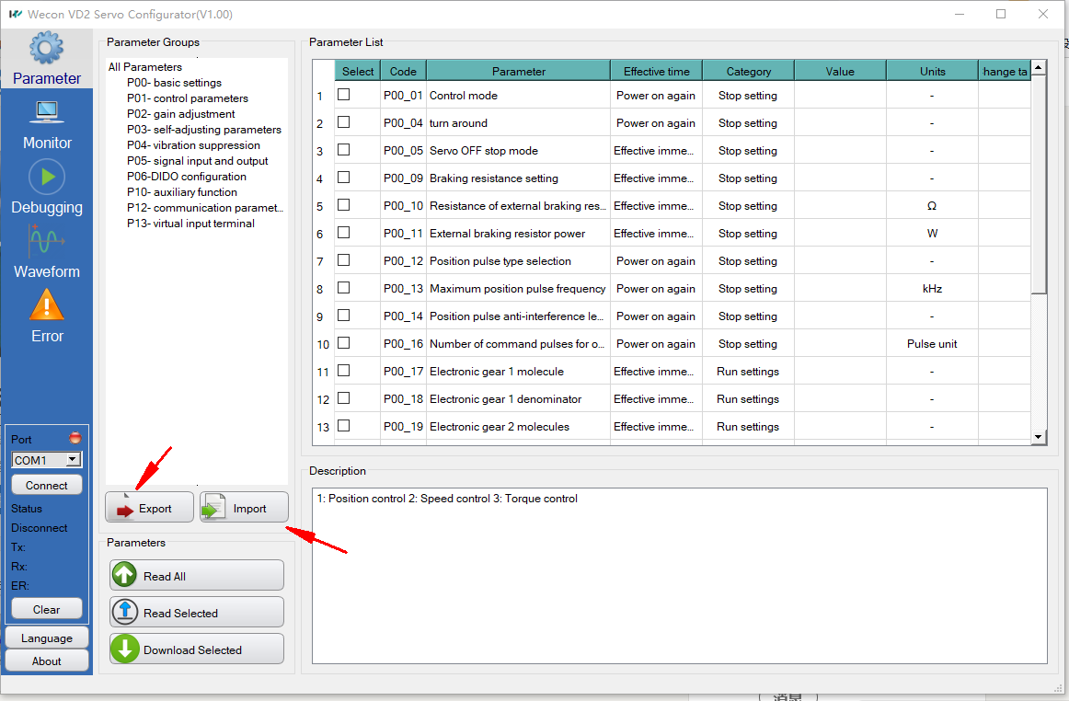
Batch Import Parameters
Batch modify parameters;
Parameters can be saved and backed up separately;
One-click Import, one-click download;
Improve the efficiency of parameter configuration.
Batch import…
Notes:
After batch use, you can batch import or export parameters. The software support Batch modify parameters, saved and backed up the parameters separately; One-click Import, one-click download; Improve the efficiency of parameter configuration. This makes it easier for engineers to debug multiple devices.

Slide 24
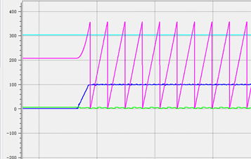
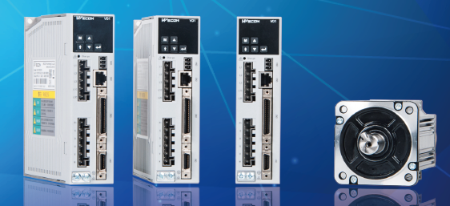
4-Channel Real-time Oscilloscope
Support recording function, convenient for remote debugging;
Support up to 10 seconds waveform recording;
Support capture, easy to view waveform;
Support the capture of original waveform data, accurately restore the dynamic details of the scene
Notes:
We have 4-channel real time oscilloscope, it support recording function, convenient for remote debugging; Support up to 10 seconds waveform recording; Support capture, easy to view waveform; Support the capture of original waveform data, accurately restore the dynamic details of the scene. When the customer has a problem, the waveform can be sent to the engineer to judge the on-site situation.

Slide 25
Parameters Adjustment
Notes:
In this video, you can see how to using real time oscilloscope to adjust parameters. You can recording a 10 seconds waveform to analysis. Usually we can according to the changes in the waveform to make timely adjustments.

Slide 26
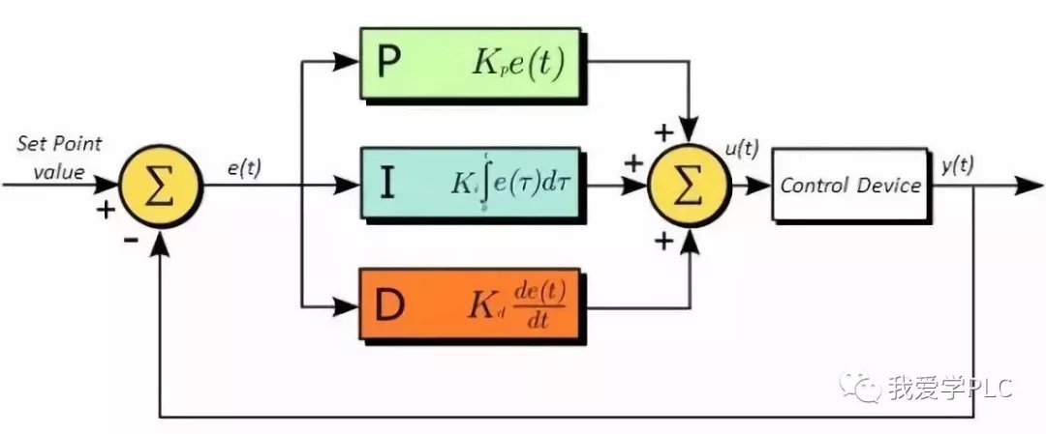
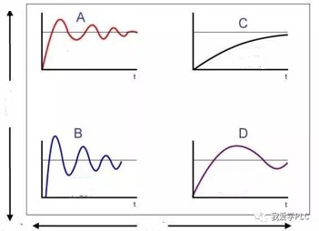
Parameter Tuning
The servo parameters are not adjusted properly ,it's like a car running at a high speed use first gear.
To achieve the best control effect, it is necessary to set these parameters correctly
Position loop gain;
Speed loop gain Kp;
Integral time constant Ki of velocity loop;
Time constant of torque filtering;
Load inertia ratio;
Notes:
The servo parameters are not adjusted properly ,it's like a car running at a high speed use first gear.
PID Parameter Tuning.

Slide 27
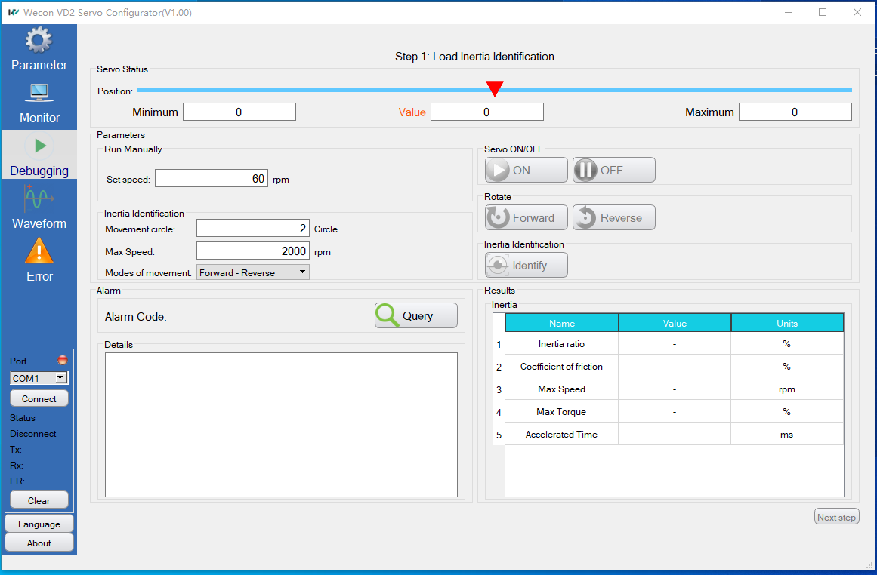
Servo Software
Load inertia ratio；
Load rigidity class；
Position gain parameter ；
Velocity loop gain Kp；
Integral time constant of velocity loop Ki；
Torque filtering time constant；
Observation effect of "trial run"
Notes:
What if they are not experienced engineers? Wecon servo software provide easy solution, it help engineer to set parameters.

Slide 28
Parameter Self-tuning
Notes:
The video is show self-tuning progress. After the parameter self-tuning, the waveform is displayed normally

Slide 29
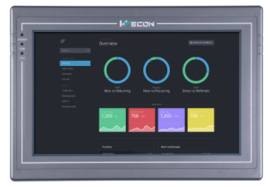
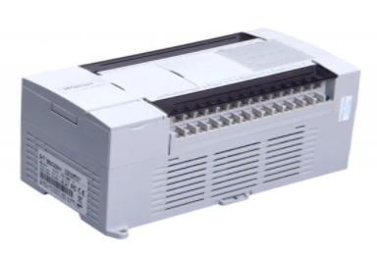
RS485 Automatic Address Assignment
Configure servo parameters
Auto assign servo MODBUS address
Automatically download servo configuration parameters;
Support multi axis servo;
Multi axis servo parameters are independent;
Set by pressing the key
Set by servo software
Set by RS485 communication
Notes:
We have three ways to configure servo parameters. The key, software and HMI. It can easily implement one key configuration.

Slide 30
VD2 Servo & Motor Model Selection
Notes:
VD2 Servo & Motor model selection

Slide 31
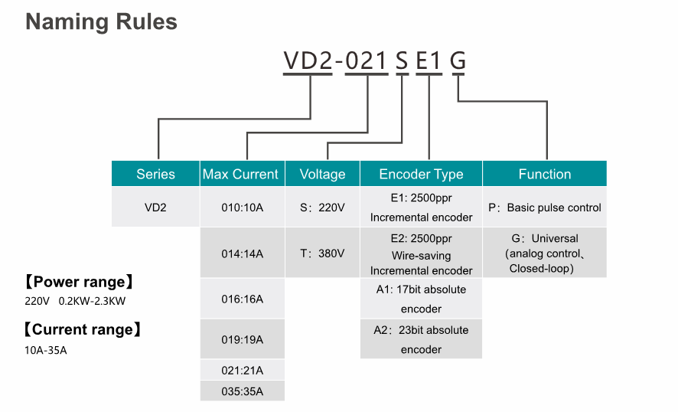
Notes:
This is servo driver’s naming rules

Slide 32
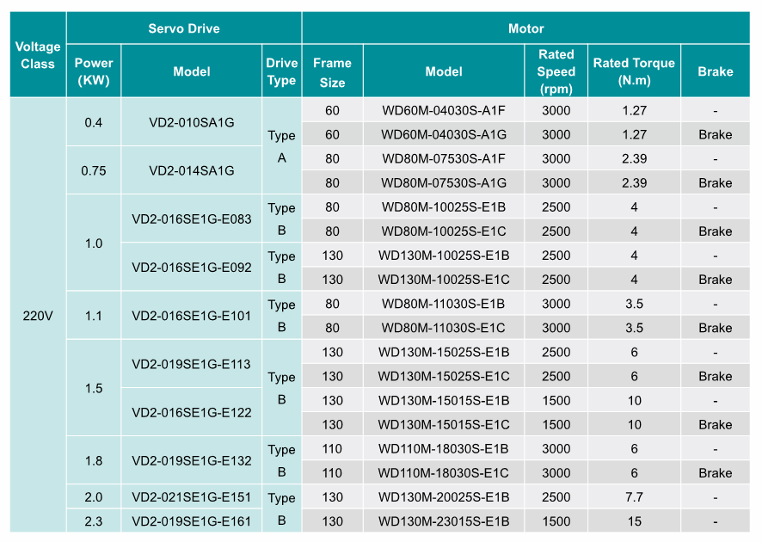
VD2 Servo and Motor Product Line-up
Notes:
This is VD2 Servo and Motor Product Line-up…

Slide 33
THANK YOU
Notes:
Thank you for your watching. Bye Bye.

